Slide 1
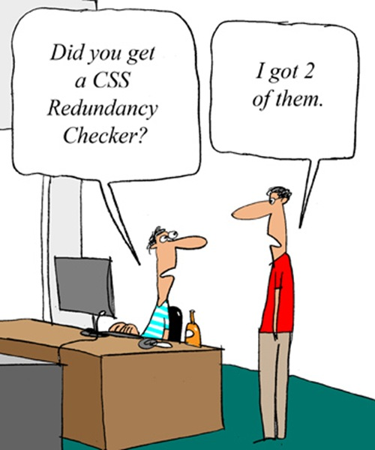
Web Programming
CSS for styling

Slide 2
Today’s Topics
Basic CSS
Basic CSS
CSS Properties
More CSS Syntax

Slide 3
Today’s Topics
Basic CSS
Basic CSS
CSS Properties
More CSS Syntax

Slide 4

The bad way to produce styles
<p>
<font face="Arial">Welcome to Greasy Joe's.</font>
You will <b>never</b>, <i>ever</i>, <u>EVER</u> beat
<font size="+4" color="red">OUR</font> prices!
</p> HTML
Welcome to Greasy Joe's. You will never, ever, EVER beat OUR prices! output
Tags such as b, i, u, and font are discouraged in strict HTML
Why is this bad?

Slide 5
Cascading Style Sheets (CSS): <link>
<head>
...
<link href="filename" type="text/css" rel="stylesheet" />
...
</head> HTML
<link href="style.css" type="text/css" rel="stylesheet" /> HTML
CSS describes the appearance and layout of information on a web page
as opposed to HTML, which describes the content of the page
can be embedded in HTML or placed into separate .css file (preferred)
Notes:
样式表极大地提高了工作效率

Slide 6
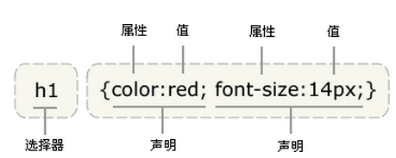
Basic CSS rule syntax
selector {
property: value;
property: value;
...
property: value;
} CSS
p {
font-family: sans-serif;
color: red;
} CSS
a CSS file consists of one or more rules
a rule's selector specifies HTML element(s) and applies style properties
a selector of * selects all elements
Notes:
Selector:选择器
CSS 语法
CSS 规则由两个主要的部分构成：选择器，以及一条或多条声明。
selector {declaration1; declaration2; ... declarationN }

Slide 7
CSS properties for colors
p {
color: red;
background-color: yellow;
} CSS
This paragraph uses the style above. output
Property | Description
color | color of an element’s text
background-color | color that will appear behind the element

Slide 8
Specifying colors
p { color: red; }
h2 { color: rgb(128, 0, 196); }
h4 { color: #FF8800; } CSS
This paragraph uses the first style above.
This h2 uses the second style above.
This h4 uses the third style above. output
color names: aqua, black, blue, fuchsia, gray, green, lime, maroon, navy, olive, purple, red, silver, teal, white (white), yellow
RGB codes: red, green, and blue values from 0 (none) to 255 (full)
hex codes: RGB values in base-16 from 00 (0, none) to FF (255, full)

Slide 9
CSS properties for fonts
property | description
font-family | which font will be used
font-size | how large the letters will be drawn
font-style | used to enable/disable italic style
font-weight | used to enable/disable bold style
Complete list of font properties

Slide 10
font-family
enclose multi-word font names in quotes
p {
font-family: Georgia;
}
h2 {
font-family: "Courier New";
} CSS
This paragraph uses the first style above.
This h2 uses the second style above. output

Slide 11
More about font-family
can specify multiple fonts from highest to lowest priority
generic font names:
serif, sans-serif, cursive, fantasy, monospace
p {
font-family: Garamond, "Times New Roman", serif;
} CSS
This paragraph uses the above style. output
Notes:
在 CSS 中，有两种不同类型的字体系列名称：通用字体系列 - 拥有相似外观的字体系统组合（比如 "Serif" 或 "Monospace"）特定字体系列 - 具体的字体系列（比如 "Times" 或 "Courier"）
除了各种特定的字体系列外，CSS 定义了 5 种通用字体系列：Serif 字体Sans-serif 字体Monospace 字体Cursive 字体Fantasy 字体
使用通用字体系列如果你希望文档使用一种 sans-serif 字体，但是你并不关心是哪一种字体，以下就是一个合适的声明：
body {font-family: sans-serif;}
这样的规则同时会产生另外一个问题，如果用户代理上没有安装 Georgia 字体，就只能使用用户代理的默认字体来显示 h1 元素。我们可以通过结合特定字体名和通用字体系列来解决这个问题：
h1 {font-family: Georgia, serif;}

Slide 12
font-size
p {
font-size: 14pt;
} CSS
This paragraph uses the style above. output
units: pixels (px) vs. point (pt) vs. m-size (em)
16px, 16pt, 1.16em
vague font sizes: xx-small, x-small, small, medium, large, x-large, xx-large, smaller, larger
percentage font sizes, e.g.: 90%, 120%
Notes:
独立单位
emem：即％，是相对单位，是一个相对长度单位，最初是指字母M的宽度，故名em。现指的是字符宽度的倍数，用法类似百分比，如：0.8em, 1.2em,2em等。通常1em=16px。，一般用来测量长度的通用单位(例如元素周转的页边空白和填充),当用于指定字体大小时,em单位是指父元素的字体大小。

Slide 13
font-weight, font-style
either of the above can be set to normal to turn them off (e.g. headings)
p {
font-weight: bold;
font-style: italic;
} CSS
This paragraph uses the style above. output
Notes:
默认值： normal

Slide 14
Recall: Basic CSS rule syntax
selector {
property: value;
property: value;
...
property: value;
} CSS
p {
font-family: sans-serif;
color: red;
} CSS
Notes:
出现的意义？

Slide 15
Grouping styles
p, h1, h2 {
color: green;
}
h2 {
background-color: yellow;
} CSS
This paragraph uses the above style.
output
This h2 uses the above styles.
A style can select multiple elements separated by commas
The individual elements can also have their own styles

Slide 16
CSS comments: /* ... */
/* This is a comment.
It can span many lines in the CSS file. */
p {
color: red;
background-color: aqua;
} CSS
CSS (like HTML) is usually not commented as much as code such as Java
the // single-line comment style is NOT supported in CSS
the <!-- ... --> HTML comment style is also NOT supported in CSS

Slide 17
W3C CSS Validator
<p>
<a href="http://jigsaw.w3.org/css-validator/check/referer">
<img src="http://jigsaw.w3.org/css-validator/images/vcss"
alt="Valid CSS!" /></a>
</p> CSS
output
http://jigsaw.w3.org/css-validator/
checks your CSS to make sure it meets the official CSS specifications
more picky than the web browser, which may render malformed CSS correctly
Notes:
malformed ^{报错} 美 [,mæl'fɔrmd] 全球发音 跟读 口语练习
adj. 畸形的，难看的

Slide 18
Today’s Topics
Basic CSS
Basic CSS
CSS Properties
More CSS Syntax

Slide 19
CSS properties for text
property | description
text-align | alignment of text within its element
text-decoration | decorations such as underlining
line-height, word-spacing, letter-spacing | gaps between the various portions of the text
text-indent | indents the first letter of each paragraph
text-shadow | a colored shadow near an existing piece of text
Complete list of text properties (http://www.w3schools.com/css/css_reference.asp#text)

Slide 20
text-align
blockquote { text-align: justify; }
h2 { text-align: center; } CSS
The Emperor's Quote
[TO LUKE SKYWALKER] The alliance... will die. As will your friends. Good, I can feel your anger. I am unarmed. Take your weapon. Strike me down with all of your hatred and your journey towards the dark side will be complete. output
can be left, right, center, or justify (which widens all full lines of the element so that they occupy its entire width)
Notes:
HTML 5 <blockquote> 标签
定义和用法
<blockquote> 标签定义摘自另一个源的块引用。
<blockquote> 与 </blockquote> 之间的所有文本都会从常规文本中分离出来，经常会在左、右两边进行缩进，而且有时会使用斜体。也就是说，块引用拥有它们自己的空间。
提示：如果标记是不需要段落分隔的短引用，请使用 <q> 元素。
注释：blockquote 只应该应用于来自另一个源的引用。

Slide 21
text-decoration
p {
text-decoration: underline;
} CSS
This paragraph uses the style above.
output
can also be overline, line-through, blink, or none
effects can be combined:
text-decoration: overline underline;
Notes:
blink定义闪烁的文本。

Slide 22
text-shadow
p {
font-weight: bold;
text-shadow: 2px 2px gray;
} CSS
This paragraph uses the style above. output
shadow is specified as an X-offset, a Y-offset, and an optional color

Slide 23
CSS properties for backgrounds
property | description
background-color | color to fill background
background-image | image to place in background
background-position | placement of bg image within element
background-repeat | whether/how bg image should be repeated
background-attachment | whether bg image scrolls with page
background | shorthand to set all background properties

Slide 24

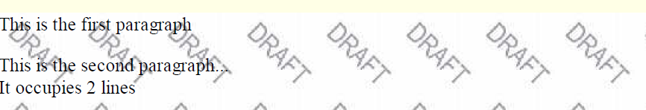
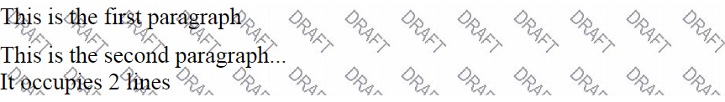
background-image
body {
background-image: url("images/draft.jpg");
}
CSS
background image/color fills the element's content area
Notes:
定义和用法
background-repeat 属性设置是否及如何重复背景图像。
默认地，背景图像在水平和垂直方向上重复。

Slide 25
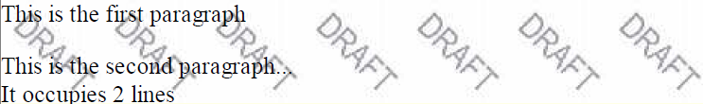
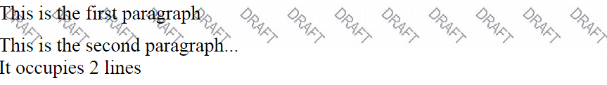
background-repeat
body {
background-image: url("images/draft.jpg");
background-repeat: repeat-x;
} CSS
can be repeat (default), repeat-x, repeat-y, or no-repeat
Notes:
可能的值
repeat默认。背景图像将在垂直方向和水平方向重复。
repeat-x背景图像将在水平方向重复。
repeat-y背景图像将在垂直方向重复。
no-repeat背景图像将仅显示一次。
inherit规定应该从父元素继承 background-repeat 属性的设置。
定义和用法
background-repeat 属性设置是否及如何重复背景图像。
默认地，背景图像在水平和垂直方向上重复。

Slide 26
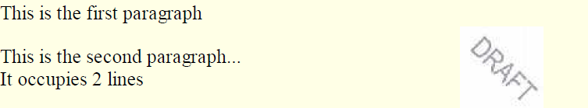
background-position
body {
background-image: url("images/draft.jpg");
background-repeat: no-repeat;
background-position: 370px 20px;
} CSS
value consists of two tokens, each of which can be top, left, right, bottom, center, a percentage, or a length value in px, pt, etc.
value can be negative to shift left/up by a given amount
Notes:
提示和注释
提示：背景图像的位置是根据 background-position 属性设置的。如果未规定 background-position 属性，图像会被放置在元素的左上角。

Slide 27
The list-style-type property
ol { list-style-type: lower-roman; } CSS
Possible values:
i. none : No marker
ii. disc (default), circle, square
iii. Decimal: 1, 2, 3, etc.
iv. decimal-leading-zero: 01, 02, 03, etc.
v. lower-roman: i, ii, iii, iv, v, etc.
vi. upper-roman: I, II, III, IV, V, etc.
vii. lower-alpha: a, b, c, d, e, etc.
viii. upper-alpha: A, B, C, D, E, etc.
x. lower-greek: alpha, beta, gamma, etc.
others: hebrew, armenian, georgian, cjk-ideographic, hiragana…
Notes:
<ol> 标签定义有序列表。

Slide 28
Today’s Topics
Basic CSS
Basic CSS
CSS Properties
More CSS Syntax
Notes:
3.2省略书chapter slides中styling tables相关和css3 new features

Slide 29
body styles
body {
font-size: 16px;
} CSS
To apply a style to the entire body of your page, write a selector for the body element
Saves you from manually applying a style to each element

Slide 30
Styles that conflict
p, h1, h2 { color: blue; font-style: italic; }
h2 { color: red; background-color: yellow; } CSS
This paragraph uses the first style above.
output
This heading uses both styles above.
when two styles set conflicting values for the same property, the latter style takes precedence

Slide 31
Embedding style sheets: <style> (BAD!)
<head>
<style type="text/css">
p { font-family: sans-serif; color: red; }
h2 { background-color: yellow; }
</style>
</head>
HTML
CSS code can be embedded within the head of an HTML page
this is bad style; DO NOT DO THIS (why?)
Notes:
定义和用法
<style> 标签用于为 HTML 文档定义样式信息。
在 style 中，您可以规定在浏览器中如何呈现 HTML 文档。
type 属性是必需的，定义 style 元素的内容。唯一可能的值是 "text/css"。
style 元素位于 head 部分中。
类似于头文件单独写。

Slide 32
Inline styles: the style attribute (BAD!)
<p style="font-family: sans-serif; color: red;">
This is a paragraph</p>
HTML
This is a paragraph
output
higher precedence than embedded or linked styles
used for one-time overrides and styling a particular element
this is bad style; DO NOT DO THIS (why?)
Notes:
定义和用法
style 属性规定元素的行内样式（inline style）
style 属性将覆盖任何全局的样式设定，例如在 <style> 标签或在外部样式表中规定的样式。

Slide 33
Content vs. presentation
HTML is for content; what is on the page (heading; list; code; etc.)
CSS is for presentation; how to display the page (bold; centered; 20px margin; etc.)
keeping content separate from presentation is a very important web design principle
If the HTML contains no styles, its entire appearance can be changed by swapping .css files
see also: CSS Zen Garden

Slide 34
Cascading style sheets
It's called Cascading Style Sheets because the properties of an element cascade together in this order:
browser's default styles (reference)
external style sheet files (in a <link> tag)
internal style sheets (in a <style> tag in the page header)
inline style (the style attribute of an HTML element)
Notes:
cascade
英 [ kæˈskeɪd ] 美 [ kæˈsked ]
GRE
n.倾泻; 小瀑布，瀑布状物; 串联
逐级override，定义优先级
二、特殊性（specificity）的规定 由于在每个等级都可能会出现同一个元素被多个css规则影响，那么最终采用哪个规则就取决于哪个规则最特殊，优先级最高。每条规则的优先级根据其 css 选择器来指定，从高到底进行比较如下： 1.行内样式最高； 2.选择器中 id 的个数，多者优先； 3.选择器中 类，属性，伪类（last-child）的个数，多者优先； 4.选择器中元素，伪元素的个数，多者优先； 5.规则在文档中的出现顺序，后者优先。

Slide 35
Inheriting styles (explanation)
body { font-family: sans-serif; background-color: yellow; }
p { color: red; background-color: aqua; }
a { text-decoration: underline; }
h2 { font-weight: bold; text-align: center; } CSS
This is a heading
A bulleted list output
A styled paragraph. Previous slides are available on the website.
when multiple styles apply to an element, they are inherited
a more tightly matching rule can override a more general inherited rule
not all properties are inherited (notice link's color above)
Notes:
继承及其问题
根据 CSS，子元素从父元素继承属性。但是它并不总是按此方式工作。
三、继承（inheritance）的作用 若某个元素没有一条规则（程序员或用户）能够直接匹配到自己，那么根据相应的css属性定义决定是否可以继承： 1.可以继承，继承其父元素的对应计算值（computed value）； 2.不可以继承，则应用浏览器（user agent）的默认值。

Slide 36
CSS pseudo-classes
a:link { color: #FF0000; } /* unvisited link */
a:visited { color: #00FF00; } /* visited link */
a:hover { color: #FF00FF; } /* mouse over link */ CSS
Buy early, buy often! output
class | description
:active | an activated or selected element
:focus | an element that has the keyboard focus
:hover | an element that has the mouse over it
:link | a link that has not been visited
:visited | a link that has already been visited
:first-letter | the first letter of text inside an element
:first-line | the first line of text inside an element
:first-child | an element that is the first one to appear inside another
:nth-child(N) | applies to every Nth child of a given parent
Notes:
CSS 伪类用于向某些选择器添加特殊的效果。
提示：在 CSS 定义中，a:hover 必须被置于 a:link 和 a:visited 之后，才是有效的。
提示：在 CSS 定义中，a:active 必须被置于 a:hover 之后，才是有效的。
提示：伪类名称对大小写不敏感。
提示：最常见的错误是认为 p:first-child 之类的选择器会选择 p 元素的第一个子元素。
正确的是：将作为某元素第一个子元素的所有 p 元素设置为xxx。

Slide 37
Thank you for your attention!

Slide 38
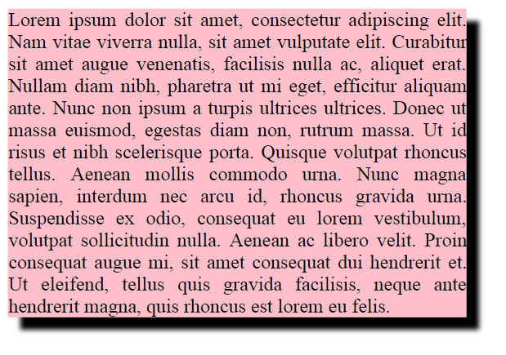
box-shadow
box-shadow: h-shadow v-shadow blur; CSS
box-shadow: 10px 10px 5px; CSS

